Slide 1


Slide 2

Violence in our Schools
Stop the Madness

Slide 3
Deadly Weapons
56
2014 – 2015 School Year
Defiance
772
Battery
338
Destruction of Property
94
Fighting
1403
Handguns
9
Intimidation
269

Slide 4
Bullying:
When someone repeatedly and on purpose says or does mean or hurtful things to another person who has a hard time defending himself or herself

Slide 5
R
Repeated:
The bullying happens over and over again
I
Intended:
The bullying happens on purpose. It is an Intentional aggressive action.
P
Power Imbalance:
The bullying creates a power imbalance causing one student to feel very small and powerless.

Slide 6
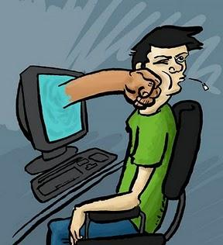
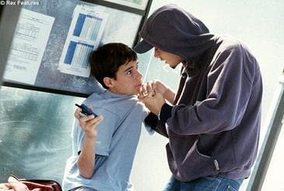

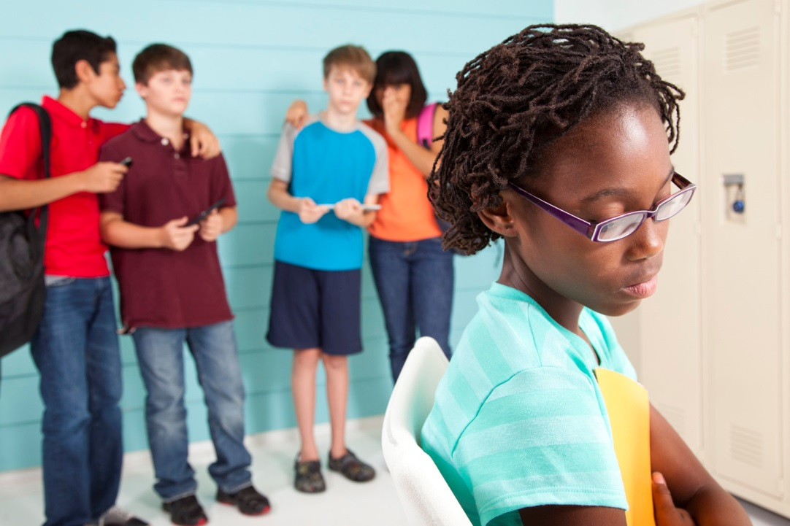
Types of Bullying

Slide 7
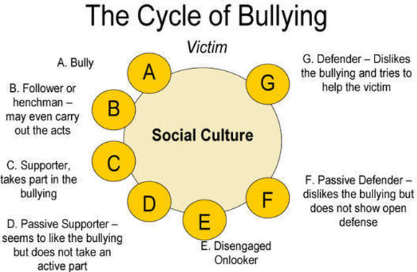

Slide 8
Stop the Madness
Pay Attention
Get Involved
Never Look Away

Slide 9
In the safest schools?
1. Teachers view parents as partners in educating the child
2. Teachers offer academic support to students
3. There is trust between teachers, student, parents,
and administration
Notes:
1. Within in the school context, the ultimate goal of discipline is to create a safe atmosphere where learning is paramount.
In your teams, discuss and write down the three top characteristics of the safest schools according to the research.

Slide 10
PBIS
Set expectations for positive behavior
Teach the positive behavior
Reinforce positive behavior

Slide 11
Finally . . .
The most important ingredient for removing violence from our schools is not the discipline code, but the quality of relationship we develop with students, staff members, and parents.

