Slide 1
Toward Justice
An Illustrative Example of a University/School Partnership Designed to Advance an Agenda for Transforming Black Education
Marvin Lynn, Ph.D., Dean & Professor, IU South Bend
Hope Davis, Ph.D., Chair & Assistant Professor, IU South Bend
G. David Moss, Ph.D., Director of African American Student/Parent Services,
South Bend Community School Corporation
Lesley Wesley, Program Director, 2015 Summer of Learning, South Bend Community Schools Corporation – 21st Century Community Learning Center

Slide 2
Director
African American Student and Parent Services
South Bend Community School Corporation
G. David Moss, Ph.D.

Slide 3
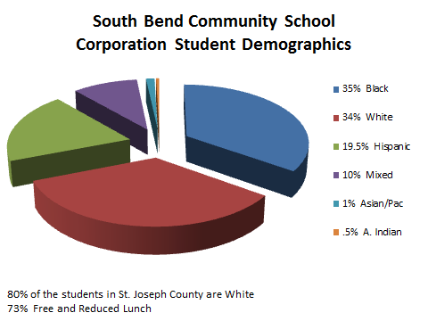

Slide 4
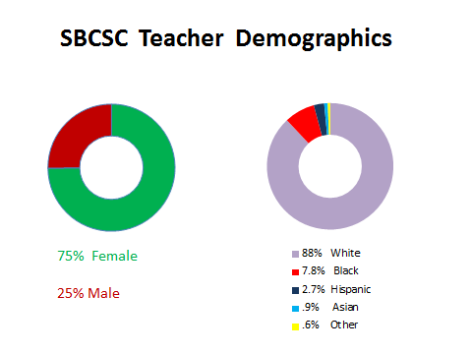

Slide 5
38% of students in Special
Education were A.A.
25% were A.A. males
50%
of the lowest performing students
academically in the
district were
A.A.
78% of the students
expelled were
A.A.
54% were A.A. males
77%
of the Special Education students recommended for expulsion were A.A.

Slide 6
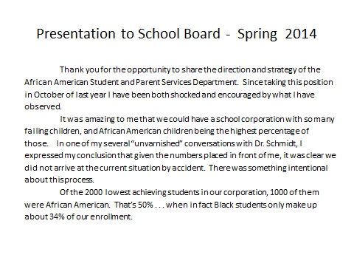

Slide 7
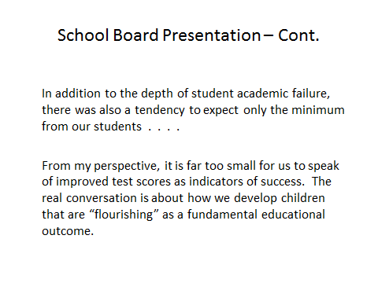

Slide 8
Flourishing Student
Busara Black Male Summit
BBMS
Mindset Inititative
Classroom Ninjas
Young Blu
Vision Quest
Alfred Tatum
Hodari Scholars
Chesare Warren
G. David Moss
Ericka Harris
On Your Mark

Slide 9
Outcomes
Permission
Teacher Motivation
BROTHERS
Caring
Unprecedented Mobilization of Black Men in the Community

Slide 10
Outcomes
Permission
Teacher Motivation
BROTHERS
Caring
Unprecedented Mobilization of Black Men in the Community

