Slide 1
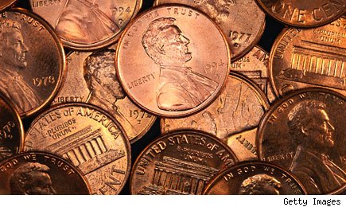

Slide 2
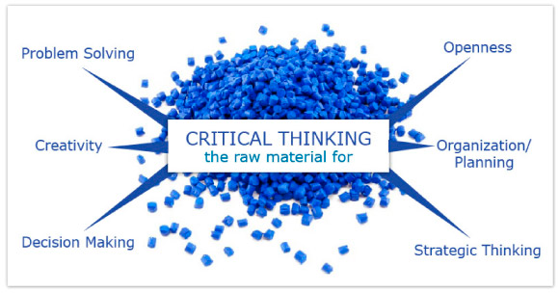

Slide 3
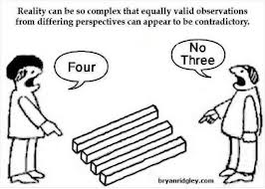

Slide 4
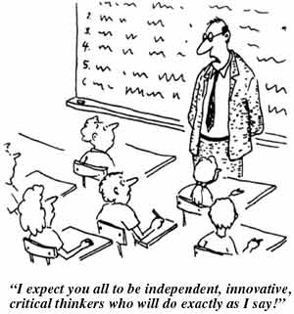

Slide 5
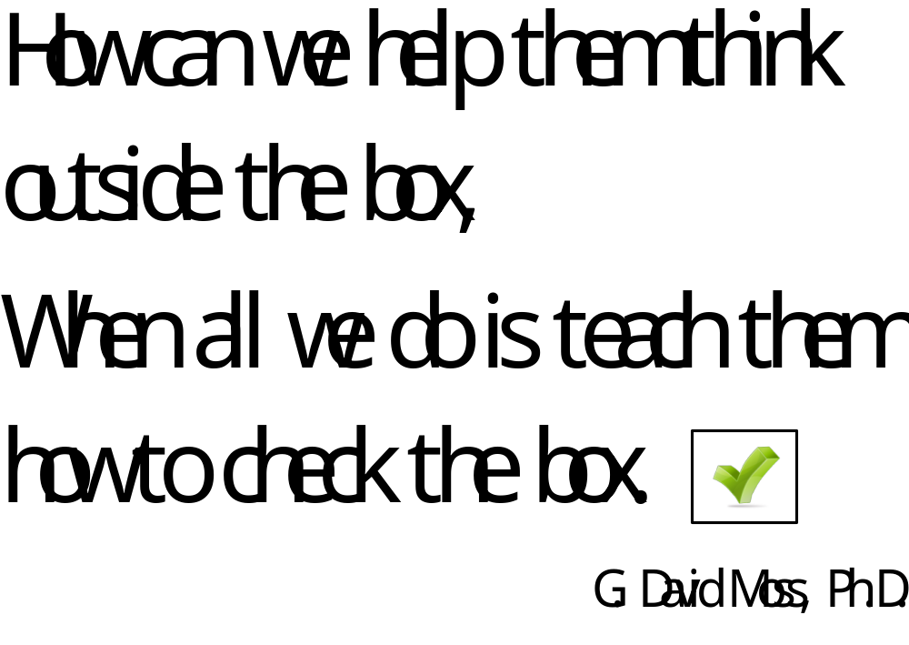

Slide 6
Animals
Product Centered
Dumb Men
Sexual
Funny
Thought Provoking

Slide 8
