Slide 1



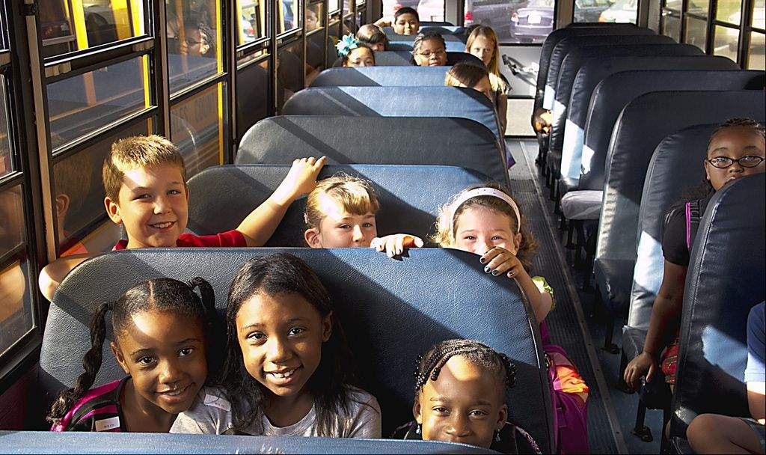
South Bend Community School Corporation
School Bus Drivers
PBIS - Training
“Positive Behavioral Interventions and Supports”
August 10 - 11, 2016

Slide 2
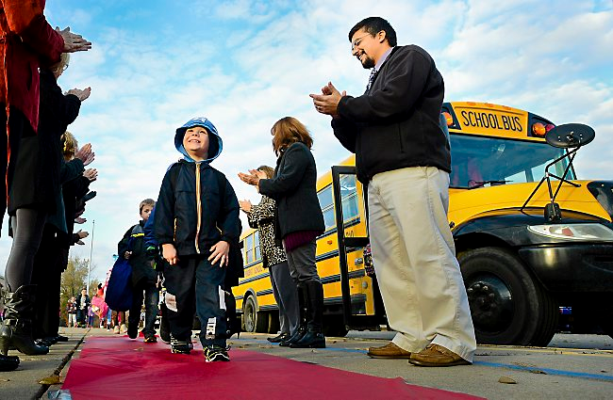
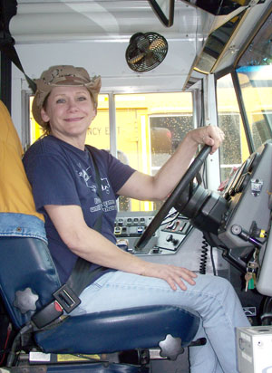
Positive
PBIS is
Proactive
Rather than
Reactive

Slide 3
Behavioral
PBIS believes
Children learn poor behavior,
AND
Children can learn
appropriate behavior

Slide 4
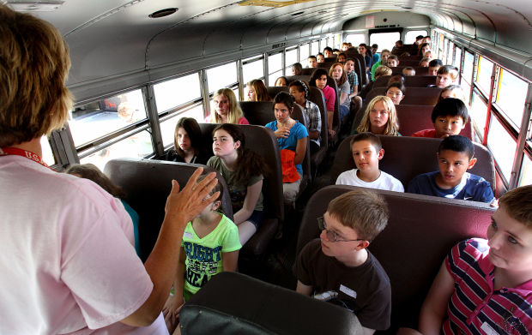
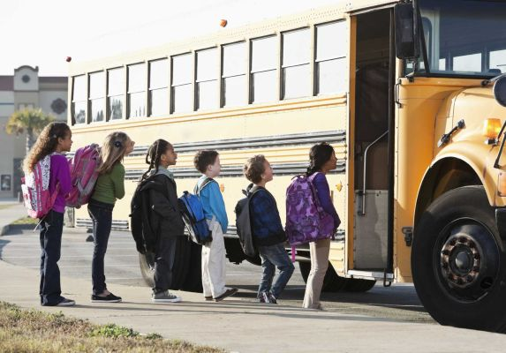
Interventions
Teaching
Reminding
Reinforcing

Slide 5


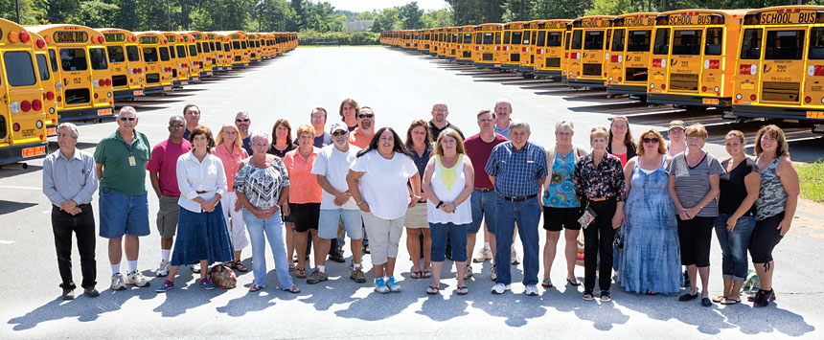
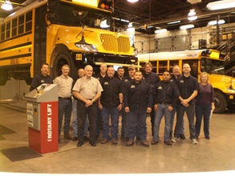
Supports
Collaboration
Consensus
Consistency

Slide 6
Tertiary Prevention:
Specialized
Individualized
Systems for Students with High-Risk Behavior
CONTINUUM OF
SCHOOL-WIDE
INSTRUCTIONAL &
POSITIVE BEHAVIOR
SUPPORT
~5%
Secondary Prevention:
Specialized Group
Systems for Students with At-Risk Behavior
~15%
Primary Prevention:
School-/Classroom-
Wide Systems for
All Students,
Staff, & Settings
~80% of Students
Notes:
SAY: One of the most important organizing components of PBS is the establishment of a continuum of behavior support that considers all students and emphasizes prevention. This logic of this 3-tiered approach is derived from the public health approach to disease prevention.
All students and staff should be exposed formally and in an on-going manner to primary prevention interventions. Primary prevention is provided to all students and focuses on giving students the necessary pro-social skills that prevents the establishment and occurrence of problem behavior. If done systemically and comprehensively, a majority of students are likely to be affected.
Some students will be unresponsive or unsupported by primary prevention, and more specialized interventions will be required. One form of assistance is called secondary prevention, and is characterized by instruction that is more specific and more engaging. These interventions can be standardized to be applied similarly and efficiently across a small number of students. The goal of secondary prevention is to reduce/prevent the likelihood of problem behavior occurrences, and to enable these students to be supported by the school-wide PBS effort.
If primary prevention is in place, a small proportion of students will require highly individualized and intensive interventions. The goal or tertiary level interventions is to reduce the intensity, complexity, and impact of the problem behaviors displayed by these students by providing supports that are (a) function-based, (b) contextually appropriate and person-centered, (c) strength-based and instructionally oriented, (d) continuously evaluated and enhanced, and (e) linked to the school-wide PBS approach.

Slide 7
PBIS Environments . . .
Teach appropriate behavior in all settings.
Intervene when behavior expectations are not met.
Recognize when behaviors are met.

Slide 8
What If?
Played something inspirational
as you transported children
Established a daily positive routine
Used the name of each
child in a positive morning/afternoon greeting
Said “Please” and “Thank You” to your students with a positive tone
Take
care of
problems as
quickly as possible
Assigned seats for primary students
Used I Messages
Realized that the education of our children begins and ends with you!

Slide 9
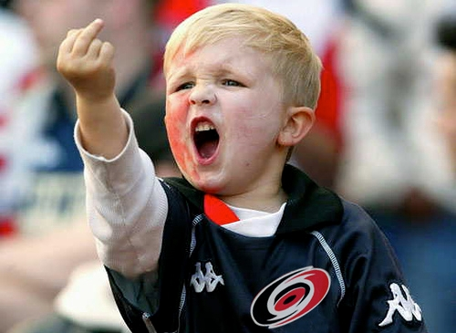
But you still get . . . . .

Slide 10
Homework!
1. Think about some of your challenging children.
2. How did you respond?
Would you have changed anything about your
response?
4. Come prepared to discuss

Slide 11
WORKING AGREEMENTS
Agreement #1
Conflict is a part of everyday life.
Agreement #2
Reasoning with an enraged child is not possible.
Agreement #3
De-escalation techniques are abnormal.
Agreement #4
Practice makes perfect.
Notes:
1. Conflict does not have to lead to violence. 2. Objective of De-escalation is to reduce level of arousal so that discussion becomes possible. 3. We are driven to Fight/Flight/ or Freeze when scared. You must appear centered and calm even when you are not.

Slide 12
Verbal De-Escalation
A. Self-Control
B. Position-Control
C. Language-Control

Slide 13
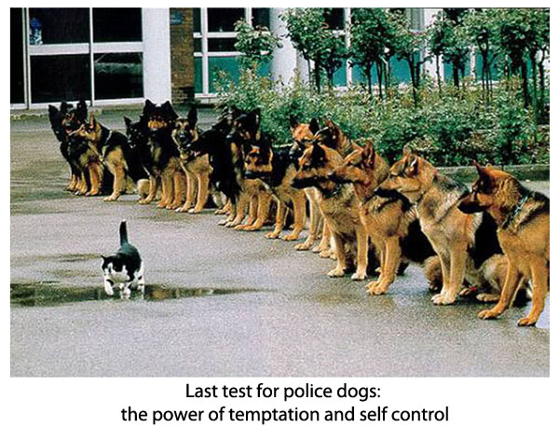
Self-Control
Recognize the source
Don’t judge
Remain and appear calm, rational, and professional
Choose wisely what you insist upon
Don’t argue or try to convince

Slide 14
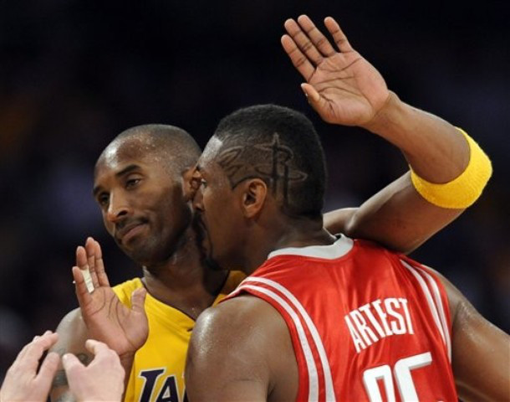
Position-Control
Stay eye-level
Do not touch
Do not smile
Stand at an angle
No constant eye contact
Give extra personal space
Keep hands out of pockets
Use non-threatening body language
Do not point or shake your finger

Slide 15

Language-Control
Do not get too loud or yell
Listen for the real message
Allow silence for reflection
Blame SBCSC, nothing personal
Trust your instincts
Speak simply, be clear, set limits
Give consequences without anger
Do not answer abusive or challenging questions
Emphathize with the feelings but not the behavior

Slide 16
Bottom Line
You are transferring your sense of calm to the student.
This is done in a atmosphere of genuine interest in hearing what the student wants to tell you.
This process is respectful and facilitates the setting of clear, rational limits for the student

Slide 17
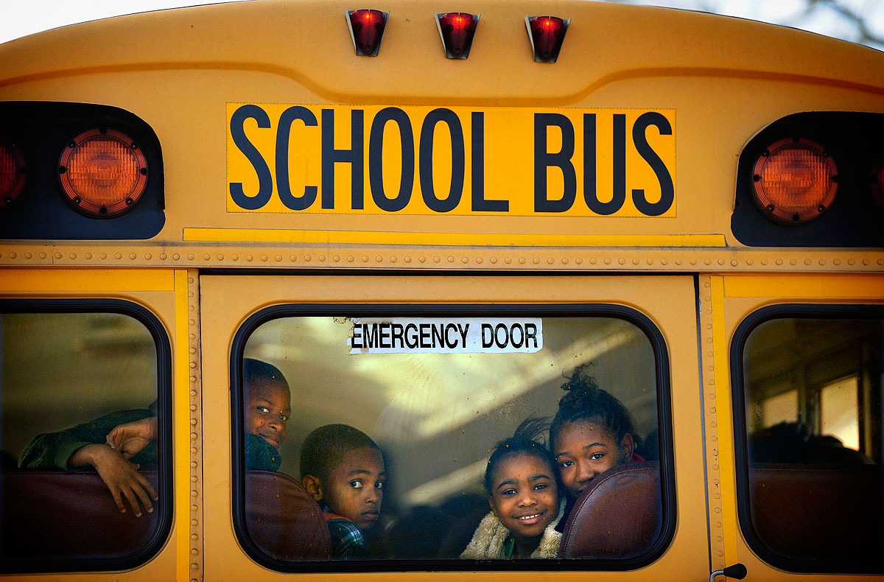
South Bend Community School Corporation
School Bus Drivers
PBIS - Training
“Positive Behavioral Interventions and Supports”
August 4, 2015

