Slide 1
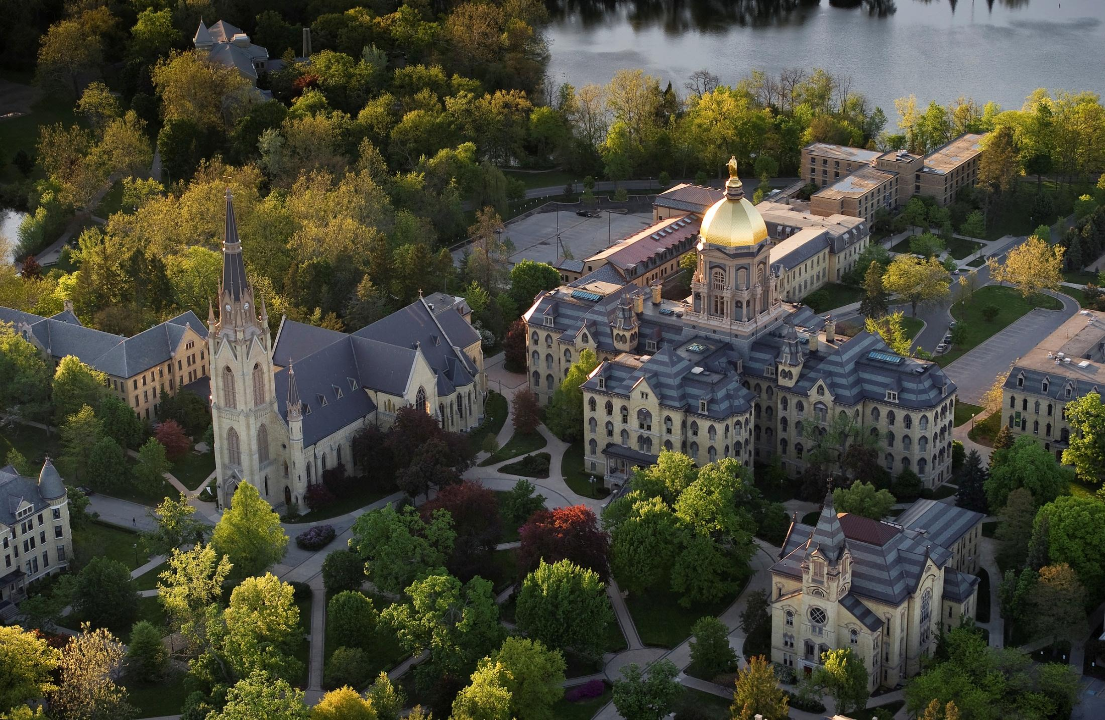
Invigorating Academic Excitement
Engaging  Never Status Quo  Uniquely Notre Dame
Division of Student Affairs  March 26, 2013

Slide 2
Academic Integration Activities Underway
Academic Advising
Meals & Conversation
Upper-class mentoring
In-house tutoring for math and engineering
Department information night
Discernment dinners
Invite your favorite professor to Dinner
Professors preparing a meal
Discussion Groups
Formal Affiliations
Current event discussions
Ongoing discussion groups
Faculty Fellow
Faculty research (Nepal)

Slide 3

Academic Integration Activities Underway
Faculty presentations: “The Integration of Faith in Academic Life”
Hall academic forum: “State of Arrest: Perspective of Law Enforcement and the South Bend Community on the Issue of Student Citizenship”
Female campus leaders: “Professional and Family Life . . . The Delicate Balance”
Alumni research and professional development
Campus Institute sponsored programming (Nanovic)
Field trips (Sustainability farming; Merchant of Venice)
Academic social activities (Debate watch w/facilitated discussion)

Slide 4

Current Levels of Participation
Undergraduate halls have at least 1 planned academic focused event
13
8
Academic presentations in halls by faculty
Academic advising programs in place
120
Students attended a discernment dinner fall 2012
7
Halls with events involving casual interaction with faculty
2
Undergraduate halls with more than 5 events

Slide 5
What’s Working
Discernment dinners: positive reviews and high impact
Faculty fellows
  “We have great relationships with two faculty fellows. They have involved our women in their research and have been excellent role models.”
  “Our hall fellow has a dynamic relationship with the men in our hall. He is an integral part of the hall experience, and the majority of his interaction with our residents is outside the realm of academic lecturing.”
In-house tutoring: Great impact, but could broaden beyond math and engineering
Halls that use upper class students to help First-year students select majors/courses indicated that this is one of the best things they do to both engage upper class students and academically advise First-year students.
Notes:
All halls who participated in a Discernment Dinner thought it was an excellent event and would like to see it’s continuation. There have been six dinners this academic year with 120 students in attendance.
The halls with faculty fellows spoke most favorably about the important relationship between the hall fellow and hall residents.
“We have great relationships with two faculty fellows. They have involved our women in their research and have been excellent role models.”
“Our hall fellow has a dynamic relationship with the men in our hall. He is an integral part of the hall experience , and the majority of his interaction with our residents is outside the realm of academic lecturing.”
The halls that have in-house tutoring enjoy the academic flavor it brings to the hall and some would like to broaden it to include areas other than math and engineering.
Halls that use upper class students to help First-year students select majors/courses indicated that this is one of the best things they do to both engage upper class students and academically advise First-year students.

Slide 6
Opportunities for Growth
Faculty presentations were better appreciated when the faculty member was 1) genuinely excited about the topic and 2) able to go beyond presentation material and discuss other issues, i.e., personal direction and goals, alignment of academics and life, etc.
Although we have 29 CSCs in residence, some of whom are faculty members, there is no systematic structure or set of expectations for their participation in hall life.
Academic commissioners receive little training and typically plan events that focus on their individual majors
There appears to be no consistent set of criteria that will guarantee a large audience at academically focused events.

Slide 7
Creating an Objective Framework
Academic Excitement
Pervasive
Exciting
Collaborative
Excellence
PEEC – pronounced “PEAK”

Slide 8
Guiding Objectives for Future Efforts
Academic Excitement
Pervasive
1. Create a residence hall culture where informal intellectual discussions between students are common place both in the residence hall and in “real-life” settings.
Academic Excitement
Exciting
2. Increase the level of academic excitement on campus by augmenting the amount of time students spend with faculty members in non-classroom settings.

Slide 9
Creating an Objective Framework
Academic Excitement
Excellence
3. Increase the quality of hall programming related to intellectual engagement.
Academic Excitement
Collaborative
Engage stakeholders (Faculty; Rectors; Students)
in mutually beneficial and dynamic relationships
that support the University’s academic and residential missions.

Slide 10
Internal Information Gathering
Rector Academic Integration Working Group (RAIWG)
Cynthia Broderick; Meghan Brown; Scott Opperman;
Annie Selak; Noel Terranova; Fr. Ron Vierling
Faculty
Members surveyed were selected based upon previous involvement with academic integration, recent arrival from institutions that have vibrant intellectual environments, and the recommendation of Don Pope-Davis.
Personal Interviews: Kevin Barry; Elly Brenner; Tom Burish; Phillippe Colone; Paulette Curtis; Stuart Green; Lacey Haussamen; George Howard Hugh Page; Don Pope-Davis
Focus Groups: Tom Anderson; Laura Carlson; Dean’s Council; Susan Ohmer; Kinohi Nishikawa; Gina Shropshire;

Slide 11
Gathering Information: Students
Student Feedback was derived from various segments of the campus community which included: Student Government; CUSE; Academic Commissioners; and other students interested in this topic. Information was gathered from focus group conversations and one panel discussion.
Lindsey Brown Kevin McDermott Jacob Coleman Katie Schmidt John Cotter Alex Sun
Meredith Holland Molly Toner
Ally Kirst Brian Vogt Holden Lombard Kyle Witz
Sean Long Sue Yee

Slide 12














Benchmarking Other Institutions
Educational Advisory Board
Telephone Interviews
Notes:
Benchmarked Institutions were chosen based on AAU Private Institution categorization and recommendations from by Tom Burish, Don Pope-Davis, and Erin Hoffmann Harding.

Slide 13
Selected Focus Group Comments
Creating Academic Excitement
We need to make learning more relevant to what we see in the world. Student
I would love to have every first-year student having dinner in a faculty member’s home. Dean
We are motivated by professors who want to teach, who are willing to go the extra mile. Student
Students need to make connections with the idea that employers need and want critical thinkers. Reflective thinking is a job skill that employers are seeking. Faculty
Academic excitement instead of evaluation. Student

Slide 14
Selected Focus Group Comments
Suppressing Academic Excitement
Freshmen don’t feel integrated. We need new programming to and engage them earlier. Student
Need to find a balance. Is this my home or just an extended classroom. Rector
Students have never been more segregated. Technology has not helped them to foster healthy/ authentic relationships. Faculty
We have great busy workers, not great intellectual engagers. They are goal oriented and driven. Rector
Our students binge or bust, unfortunately this is modeled by faculty. Faculty
There is little opportunity for students to reflect upon and share their transformative study abroad experience with classmates. Faculty

Slide 15
Looking at the Process
47 Distinct Ideas
Rectors
Faculty
External
Benchmarking
Students
Short list of five (5) ideas for further discussion and implementation.
A sixth idea worthy of pursuing that warrants extensive planning and significant resources.
RAIWG*
EHH*
*Rector Academic Integration Working Group
*Erin Hoffmann Harding

Slide 16
Selected Academic Integration Menu Items
Selection was based on implementation parameters, constituent groups’ (faculty, rectors, students) projected interest, and long term sustainability.
A. Schedule mandatory classes (philosophy/theology/university seminar) based on where students live.
B. Assign First-Year Advisors by the number of students they have in a particular hall and have academic advising done in the hall.
C. Incentivize senior student leadership.
D. Faculty-in-Residence.
E. Faculty Conversations via the Arts
F. Sophomore Summit

Slide 17
Connecting Menu Items to Objectives

Slide 18
Invigorating Academic Excitement
Engaging  Never Status Quo  Uniquely Notre Dame
Division of Student Affairs  March 26, 2013

