Slide 1
Fighting the Culture
of Sexual Violence

Slide 2
Defining Culture
Culture
An integrated pattern of human knowledge, belief, and behavior that depends upon the capacity for symbolic thought and social learning
The set of shared attitudes, values, goals, and practices that characterizes an institution, organization, or group

Slide 3
Rape Culture
The term refers to attitudes, norms, and practices in our culture—often in the media—that treat rape and sexual violence as normal, excusable, or even desirable.
It refers to a culture that frequently treats sex and sexuality as violent, and violence as sexy, and in which much violence happens as a result.

Slide 4
Sex & Emerging Adulthood: Christian Smith’s Research
“ The sexual climate in emerging adult culture leaves many feeling entitled to act aggressively in pursuing sexual encounters, especially when alcohol or drugs are involved.”
“The particular expectations and practices… lend themselves to creating tricky situations that easily lead to unwanted, coerced & forced sex.”
    Normalcy of ‘hooking-up’, amorphous romantic relationships, abundant alcohol, easily available drugs, wide-spread partying, lack of clear personal boundaries, little older adult involvements, and the general wish to be free and crazy before settling down

Slide 5
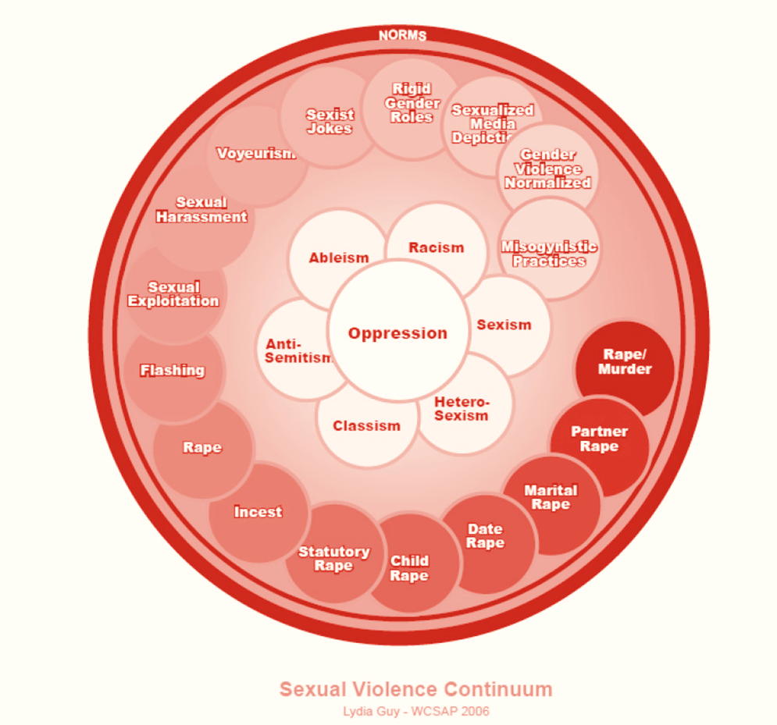
Sexual Violence Continuum

Slide 6
Alcohol and Sexual Violence
Statistics…
  Studies suggest that as many as 90% of campus rapes involve alcohol use by either assailant or victim.
Two-fold impact of alcohol use:
  encourages aggressive or disinhibited behavior;
  affects ability to give informed consent or assess risk.
ACHA study: 11% of college women sexually assaulted while incapacitated after consuming alcohol.
Notes:
The researchers surveyed more than 5,000 undergraduate women at two large public universities and found that after entering college more than 11 percent of women had been sexually assaulted while they were incapacitated and unable to provide consent, and that freshman and sophomore women were at a higher risk for sexual assault than their junior and senior counterparts.
90%: national center on addiction and substance abuse at Columbia university
Journal of American College Health: 73% of assailants and 55% of victims used alcohol or other drugs prior to assault
In terms of aggressive/disinhibited behavior, “synergistic relationship” between personality traits (low empathy, high impulsivity) and attitudes (forced sex is OK, women are coy about sexual intentions and enjoy forced sex) and alcohol’s effects. If man believes forced sex is acceptable and women can’t be trusted, he may be comfortable raping when sober

Slide 7
Alcohol and Sexual Violence
University of Buffalo study:
  5 + drinks, women are 9 times more likely to experience sexual assault
  1-4 drinks, 3 times more likely
  Study does NOT blame victims… but heightened awareness of risk may help in prevention.
Still another study…“Facts on Tap”
  70% of college students admit engaging in sexual activity primarily as a result of being under the influence of alcohol or to having sex they wouldn't have had if they had been sober
A word about statistics…

Slide 8
Other “Date Rape Drugs” on College Campuses
Three most common date rape drugs other than alcohol:
1) Rohypnol: Takes effect in 30 min, lasts several hours. Legal in Mexico and Europe.
2) GHB: May give drink slightly salty taste. Takes effect within 15 min., can last 3-4 hrs .
3) Ketamine: Very fast-acting. Widely used as animal tranquilizer.
Notes:
Ann
Ruffies stay in body for several hrs, can be detected in urine up to 72 hrs.
GHB leaves body in 12 hrs.
Ecstasy is another drug used as “date rape drug”

Slide 9
What you can do to help prevent sexual assault
1) Talk with your residents about the close connection between alcohol abuse and sexual violence.
Notes:
Ann

Slide 10
What you can do to help prevent Sexual Assault
2) Have open conversations about physical intimacy and how to establish limits/expectations.

Slide 11
What you can do to help prevent Sexual Assault
3) Relay the message that consent is impossible to obtain once alcohol is involved.

Slide 12
What you can do to help prevent Sexual Assault
4) Teach your residents to never leave friends alone at social gatherings, especially if they have been drinking.

Slide 13
What you can do to help prevent Sexual Assault
5) Talk with your residents about the close connection between alcohol abuse and sexual violence.

Slide 14
Other Campus and Local Resources
Committee on Sexual Assault Prevention
  csap.nd.edu
Gender Relations Center
Support Groups: Out of the Shadows (SOS/GRC) and SOS groups off campus
“Blind reporting”/Silent Watch Form on NDSP website
Notes:
Ann

Slide 15
2 Timothy 4:7
I have fought the good fight,
I have finished the Race
I have kept the faith

