Slide 1
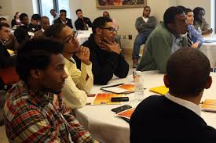
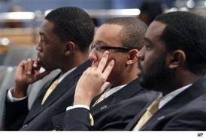

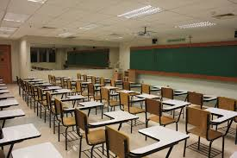
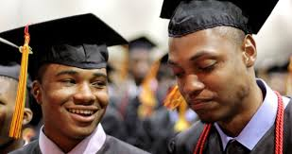
South Bend Community School Corporation
Department of African American Student/Parent Services presents
The Busara
Black Male Summit
Faith Apostolic Ministries - South Bend, IN
September 5, 2014
Notes:
900 African American High School Leaders
400 Volunteer Mentors
4 Breakout Sessions
1 Goal

Slide 2
NYANSAPO
Symbol of Wisdom – Ingenuity – Intelligence - Patience
Wisdom Knot

Slide 3
Now is the time
50% of the lowest performing students academically in
the district were African American
78% of the students expelled were African American
54% were African American males
III . 38 % of students in Special Education were African American
25% were African American males
77% of the Special Education students recommended for
expulsion were African American.
4% (239) of African American high school students had a gpa
of 3.3 or higher during the fall semester 2013.

Slide 4
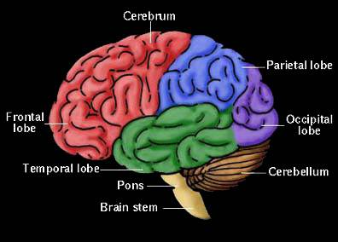
Mindset
Based on “Mindset: The Psychology of Success” by Carol Dweck
Research Based Interventions
Effective with African American Males
Strategies for increasing student motivation, effort and achievement
Growth vs. Fixed
THE POTENTIAL OF YOUR BRAIN IS IN YOUR HANDS

Slide 5
The potential of
your brain
is in your hands

Slide 6
Student Outcomes:
Become aware of the malleable nature of intelligence
and the importance of personal effort in growing IQ.
Discuss, journal and reflect on the four content areas covered during the Summit: Relationships; Partnerships; Leadership; and Vision
Experience a better connection to a greater community
designed to promote your academic and social success
1.
2.
3.

Slide 7
Busara Summit expectations
Respect for speakers
Respect for each other
No cell phones
Ask Questions
Healthy Expression - Use Journal
Challenge yourself to think beyond this room
Recognize the importance of this day

Slide 8
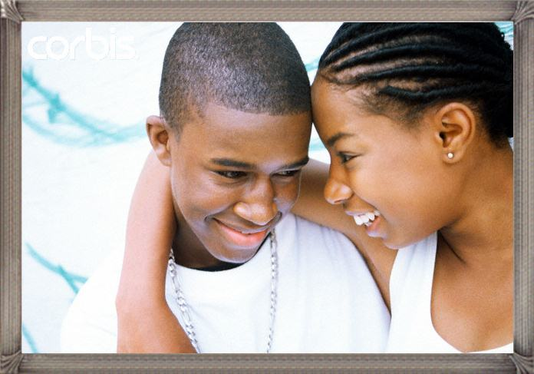
Relationships 101
    Presenters: Derek and Leslie Wesley
    Essential Question: What are the most important aspects of a healthy relationship?

Slide 9
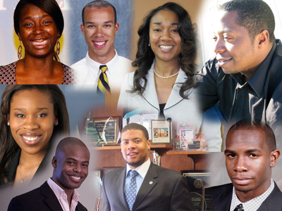
The real swag
    Presenters: Hon. Andre Gammage and Apostle Willie Coates
Essential Question: Fearless leaders are . . . ?
Fearless leaders do . . . . ?

Slide 10

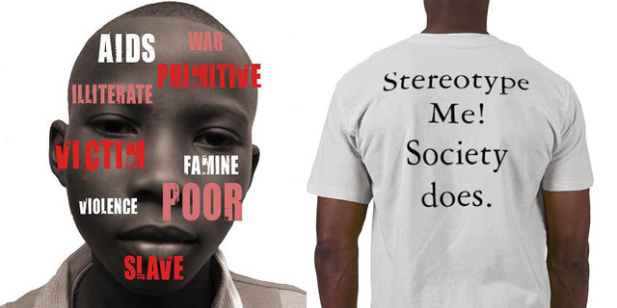
possibilities
Media Image
Self Image
    Presenter:
    Theo Williams
    Essential Question:
    Compare and contrast:
    Who I am.
    Who the media says I am.

Slide 11
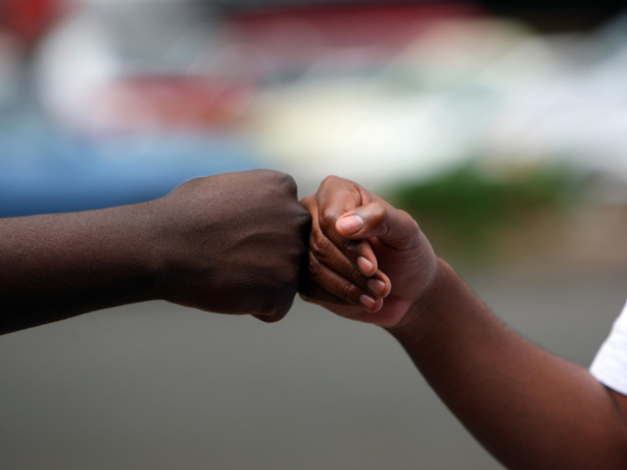
My Boys
    Essential Question: How do partnerships influence/change people’s lives? Society?
Presenters:
Jeermal Sylvester
Jason Jordan
Maurice Scott

Slide 12
The Department of African American Student/Parent Services
The Busara
Black Male Summit
Notes:
900 African American High School Leaders
400 Volunteer Mentors
4 Breakout Sessions
1 Goal

